Slide 1
Artificial Intelligence
Enrique Peláez Ph.D.

Slide 2
Agenda
Heuristic Search:
  Hill Climbing
  Simulated Annealing
  Best - First
  Admissibility Theorem

Slide 3
The traveler: Guayaquil to Quito
With the information available in the map, find the best route from Guayaquil to Quito

Slide 4
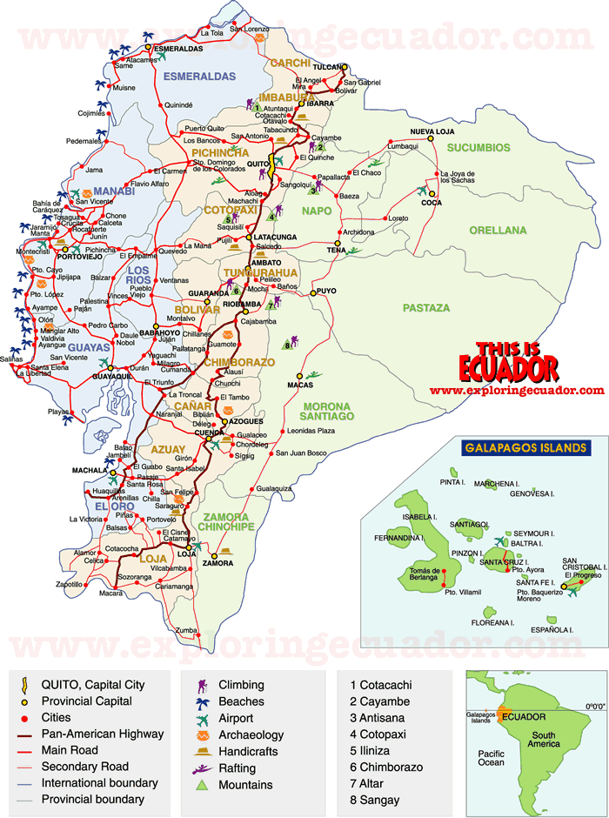

Slide 5
The traveler: Guayaquil to Quito
With the information available in the map, find the best route from Guayaquil to Quito
How did you decide the best route?

Slide 6
The traveler: Guayaquil to Quito
With the information available in the map, find the best route from Guayaquil to Quito
How did you decide the best route?
What information is missing?
How could you resolve the problem better?

Slide 7
Heuristic Search
Heuristic Search (or informed search)
  From the Greek “heuriskein”, meaning discovery or finding.
  Heuristics help or provide info to guide the search process.
  In general, with heuristics, we will not always find an optimal result (the best solution), but we will get very good results, within a reasonable time.
  Heuristics is used to solve complex problems where we usually have a combinatory explosion. In this type of problems, exhaustive search algorithms have unacceptable costs (valid only with simple problems).

Slide 8
Heuristic Search
We use heuristic information to “guess” which node to expand or explore next.
Heuristic information appears as a function, which is evaluated based on specific information for the context or problem at hand.
Hence, the solution of the search problem consists in maximizing or minimizing a function.
The heuristic function allow us to evaluate a node “locally”, based upon the estimated cost to reach the goal from the current node.

Slide 9
Heuristic Search
We use heuristic information to “guess” which node to expand or explore next.
Heuristic information appears as a function, which is evaluated based on specific information for the context or problem at hand.
Hence, the solution of the search problem consists in maximizing or minimizing a function.
The heuristic function allow us to evaluate a node “locally”, based upon the estimated cost to reach the goal from the current node.
There are some problems with heuristics:

Slide 10
Heuristic Search
We use heuristic information to “guess” which node to expand or explore next.
Heuristic information appears as a function, which is evaluated based on specific information for the context or problem at hand.
Hence, the solution of the search problem consists in maximizing or minimizing a function.
The heuristic function allow us to evaluate a node “locally”, based upon the estimated cost to reach the goal from the current node.
There are some problems with heuristics:
Heuristics might not help find the best solution - open problem. However, the A* algorithm resolves this.
….

Slide 11
Heuristic Search
Heuristics is a technique that always produces results, although, sometimes no the best ones.
A lot of what we do in real life involves heuristics; when we look for solutions or take decisions for daily problems.
Usually, the solutions work, or work well enough; and, when they do not work, we treat the problem in a different way.
Heuristics is not only applied to cases where a solution might not be available, but also for cases where we want to find a better solution.

Slide 12
Heuristic Search
As an example: Consider the problem of driving between cities: We could consider each city as a node in a tree, and the routes between cities, as an operator or rule, with some heuristic info to help the traveler move from one city to the other.

Slide 13
Heuristic Search
S
It is like depth o breath first search, but:
Instead of selecting the next node from left or right,
  It selects the node with the best heuristic value.
S
A
10.4
D
8.9
A
10.4
6.9
E
6.7
B
F
3.0
G

Slide 15
Heuristic Search
Hill Climbing
  It is an improved version of the generate and test algorithm.
  From the test procedure, there is a feedback to help the solution generator decide, which direction to go next and move in the solution space.
  In this process, the search ends if there is not a reasonable next state or node to move.

Slide 16
Heuristic Search
Hill Climbing
  Hill Climbing algorithms are typically local. Because, they decide what to do next, based only on the consequences of their immediate actions.
  They might not reach or find the best solution.
  They might get trapped in a node or nodes that are not the objective.
  For example:

Slide 17
Heuristic Search
Hill Climbing
Local maxima, it is the best state or node compared with its neighbors, but it is not the best among others, that might be ahead in the solution space.

Slide 18
Heuristic Search
Hill Climbing
Local maxima, it is the best state or node compared with its neighbors, but it is not the best among others, that might be ahead in the solution space.
Plateau or Table, it is a state in the search where a set of neighbor states have a similar value.

Slide 19
Heuristic Search
Hill Climbing
Local maxima, it is the best state or node compared with its neighbors, but it is not the best among others, that might be ahead in the solution space.
Plateau or Table, it is a state in the search where a set of neighbor states have a similar value.
Cliff, it is a special type of local maximum, which is impossible to cross with simple movements.

Slide 20
Heuristic Search
Hill Climbing
There are some ways to help resolve these problems:

Slide 21
Heuristic Search
Hill Climbing
There are some ways to help resolve these problems:
  To avoid Local Maxima, return to the best previous state and explore taking a different direction.

Slide 22
Heuristic Search
Hill Climbing
There are some ways to help resolve these problems:
  To avoid Local Maxima, return to the best previous state and explore taking a different direction.
  In Plateaus, jump in some direction and try to find a new section of the solution space.

Slide 23
Heuristic Search
Hill Climbing
There are some ways to help resolve these problems:
  To avoid Local Maxima, return to the best previous state and explore taking a different direction.
  In Plateaus, jump in some direction and try to find a new section of the solution space.
  For Cliffs, apply two or more rules before the new node or state is tested, this is equivalent to mode in different directions at once in the solution space.

Slide 24
Heuristic Search
Simulated Annealing
  It is an improved version of the Hill Climbing algorithm.
  At the beginning, this algorithm explores a good part of the solution space, in such a way that the final solution might result unaffected from the initial state.
  As a consequence, the probability to get trapped in a local maxima, or table or cliff, is small.

Slide 25
Heuristic Search
Simulated Annealing
  The SA is a computational process that reflects the steps established in a thermal physical treatment process used with materials.
  A metal is taken to a high level of energy, until it reaches a fusion state. Then, gradually it is cooled down until it reaches a predefined solid sate, with minimum energy, a level that is defined in advance.
  Because of its nature, this algorithm can be considered as “descending to a valley”, in which the objective function is the energy level defined in advance.

Slide 26
Heuristic Search
Simulated Annealing
SA differs from the Hill Climbing algorithm in 2 aspects:
  Movements to worse states, than the current state, are accepted.
  The current state and the best state from the past, need to be stored, in this way, if the current or future state gets worse, then there is always the possibility to return to that best state from the past.

Slide 27
Heuristic Search
Best - First
  This algorithm combines the advantages of breadth and depth first search algorithms.
  It follows one path at a time, but it can change the search path accordingly, based on the best promising path ahead than the current path.

Slide 28
Heuristic Search
Best - First
  This algorithm uses two lists of nodes and a heuristic function to estimate the merits of each node to be explored:

Slide 29
Heuristic Search
Best - First
  Open list – it contains the generated nodes. The heuristic function has been applied to them; but, they have not been tested yet; that is, their successors have not been generated yet. Open can be considered as a priority queue, in which the elements with higher priority are the ones with higher values, assigned by the heuristic function.
  Close list – It contains the nodes that have been examined and they where not the goal expected.
  Heuristic function – Allows the algorithm to search through the most promising paths first.

Slide 30
Heuristic Search
Best - First
  The heuristic function f can be defined as the sum of two other functions, called g and h.
  Function g is the cost to reach the current state from the initial state.
  Function h is the estimated cost to reach the objective state from the current state.
F(n) = g(n) + h(n)

Slide 31
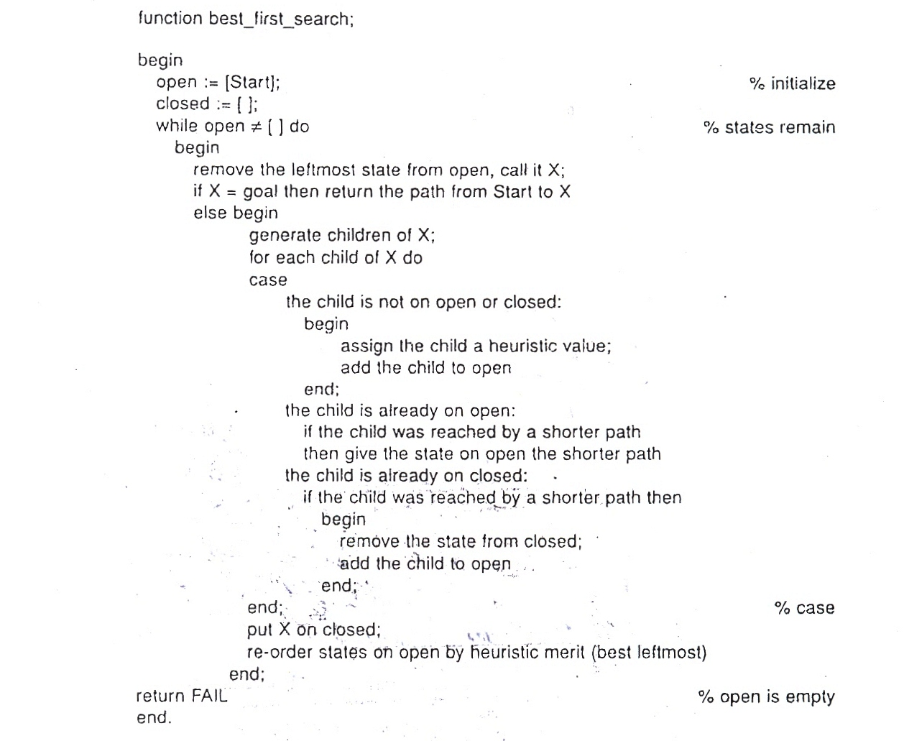
Best First

Slide 32
Best First
A-5
B-4
C-4
D-6
E-5
F-5
G-4
H-3
I
J
K
L
M
N
O-2
P-3
Q
R
S
T

Slide 33
Best First
1. open = [A5]; close [ ]
2. open = [B4, C4, D6]; close [A5]
3. open = [C4, E5, F5, D6]; close [B4, A5]
4. open = [H3, G4, E5, F5, D6]; close [C4, B4, A5]
5. open = [O2, P3, G4, E5, F5, D6]; close [H3, C4, B4, A5]
6. open = [P3, G4, E5, F5, D6]; close [O2, H3, C4, B4, A5]
7. P3 Solution

Slide 34
Best First
A-5
B-4
C-4
D-6
E-5
F-5
G-4
H-3
I
J
K
L
M
N
O-2
P-3
Q
R
S
T

Slide 35

Search Strategies

Slide 36
Frontiers

Slide 37
Breadth First
A
B
C
D
E
F
G
H
I
J
K
L
M
N
O
P
Q
R
S
T
u

Slide 38
Breadth First
open = [A]; closed = [ ]
open = [B,C,D]; closed = [A]
open = [C,D,E,F]; closed = [B,A]
open = [D,E,F,G,H]; closed = [C,B,A]
open = [E,F,G,H,I,J]; closed = [D,C,B,A]
open = [F,G,H,I,J,K,L]; closed = [E,D,C,B,A]
open = [G,H,I,J,K,L,M], L is in open; closed = [F,E,D,C,B,A]
open = [H,I,J,K,L,M,N]; closed = [G,F,E,D,C,B,A]

Slide 39
Breadth First
A
B
C
D
E
F
G
H
I
J
K
L
M
N
O
P
Q
R
S
T
u

Slide 40
Depth First
open = [A]; closed = [ ]
open = [B,C,D]; closed = [A]
open = [E,F,C,D]; closed = [B,A]
open = [K,L,F,C,D]; closed = [E,B,A]
open = [S,L,F,C,D]; closed = [K,E,B,A]
open = [L,F,C,D]; closed = [S,K,E,B,A]
open = [T,F,C,D]; closed = [L,S,K,E,B,A]
open = [F,C,D]; closed = [T,L,S,K,E,B,A]

Slide 41
Depth First
A
B
C
D
E
F
G
H
I
J
K
L
M
N
O
P
Q
R
S
T
u

Slide 42
Best First
1. open = [A5]; close [ ]
2. open = [B4, C4, D6]; close [A5]
3. open = [C4, E5, F5, D6]; close [B4, A5]
4. open = [H3, G4, E5, F5, D6]; close [C4, B4, A5]
5. open = [O2, P3, G4, E5, F5, D6]; close [H3, C4, B4, A5]
6. open = [P3, G4, E5, F5, D6]; close [O2, H3, C4, B4, A5]
7. P3 Solution

Slide 43
Best First
A-5
B-4
C-4
D-6
E-5
F-5
G-4
H-3
I
J
K
L
M
N
O-2
P-3
Q
R
S
T

